Slide 1
Overview of Microsoft 365
Speaker Name

Slide 3
Students: How to View This Presentation
To switch to Notes Page view:
On the ribbon, click the View tab, and then click Notes Page
To navigate through notes, use the Page Up and Page Down keys
Zoom in or zoom out, if required
In the Notes Page view, you can:
Read any supporting text
A list of terms used in this course is provided in the Notes section
Add notes to your copy of the presentation, if required
Take the presentation files home with you
Notes:
Terminology

Slide 4
Introduction and Logistics
Name
Role
Timing
Class: 9:00 to 5:00
Lunch: 12:00 to 1:00

Slide 5
Overview of Microsoft 365

Slide 6
Objectives
This lesson provides a high-level overview of Microsoft 365. After completing this lesson, you will be able to:
Understand the services offered by Microsoft 365
Describe the various Microsoft 365 suites and licensing options
Identify the Microsoft 365 datacenter locations
Use Service Health Dashboard and Microsoft 365 Message Center

Slide 7


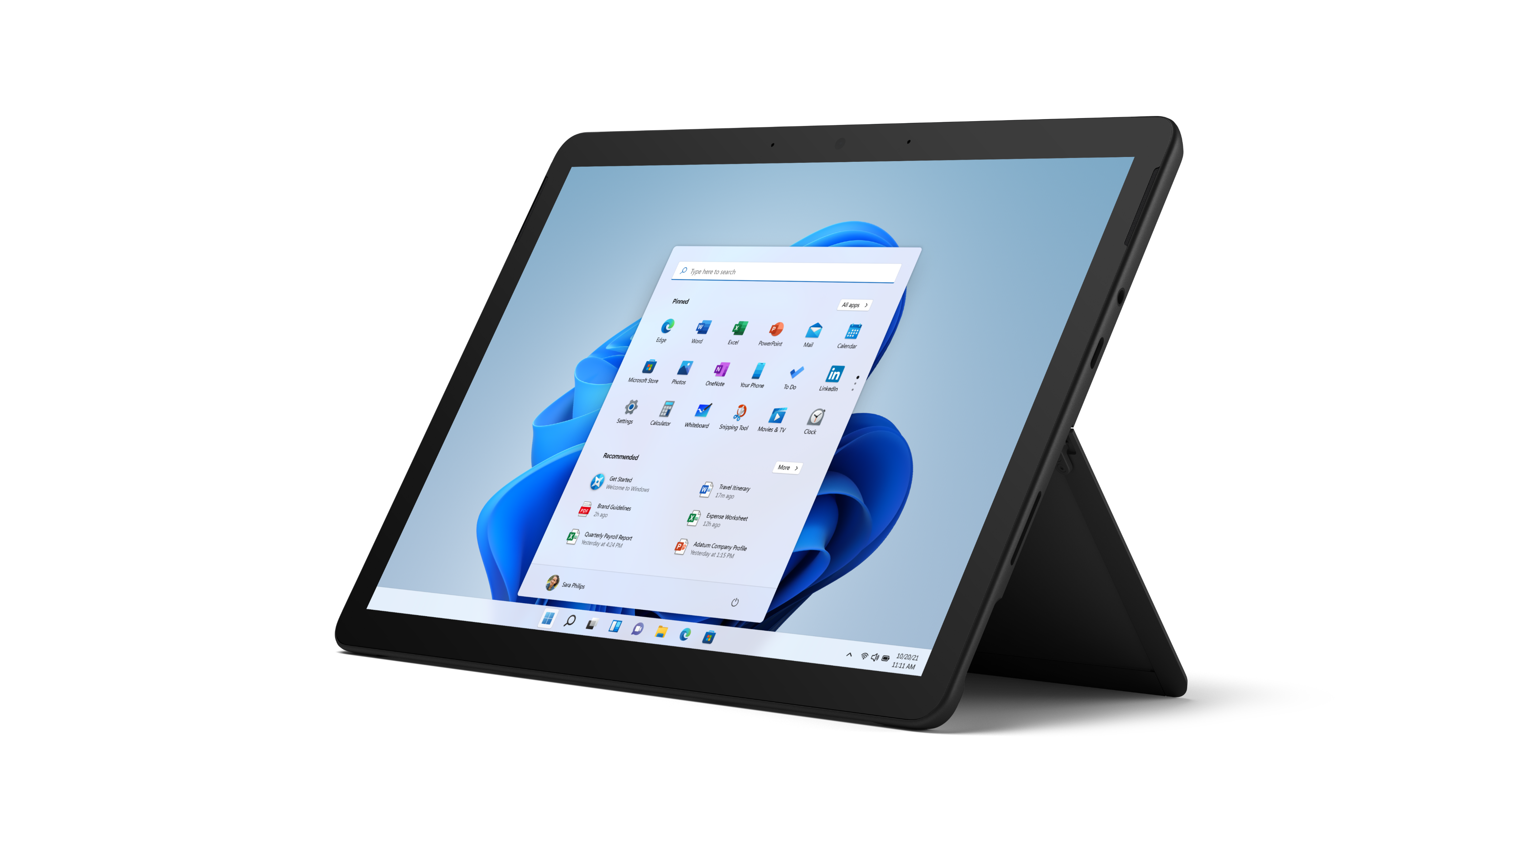
What Is Microsoft 365?
Latest productivity services running in Microsoft cloud, including
Exchange Online
SharePoint Online
Microsoft Teams
Microsoft 365 Apps
Yammer
Power Platform
Notes:
And much more

Slide 8







Microsoft 365: Benefits
Exchange
SharePoint
SharePoint
Microsoft Teams
Familiar and full
Microsoft 365 Applications
Advanced IT controls and configuration
Optimized experiences
for common devices
Reliable services run at
scale with a 99.9% SLA
Continues Innovation
Trusted Service
Notes:
Key Microsoft 365 Benefits
Anywhere-access to email, documents, contacts, and calendars on nearly any device.
Works seamlessly with Microsoft Office and the other programs your users already count on every day.
Business-class features including IT-level phone support, 99.9% uptime, geo-redundancy, and disaster recovery. For more information, refer to:
Pay-as-you-go pricing options that give you predictability and flexibility for all or part of your organization.
For information on supported browsers for Microsoft 365, see https://products.office.com/en-US/office-system-requirements/#Browsers-section
For detailed information on SLAs, see:
https://products.office.com/en-us/business/office-365-trust-center-cloud-computing-security
http://www.microsoftvolumelicensing.com/DocumentSearch.aspx?Mode=3&DocumentTypeId=37

Slide 9
Microsoft 365 Service Offerings
M365 Apps for the Enterprise
Flexible pay-as-you-go, per-user licensing
Office experience with services integration in Microsoft 365
Allows for activation on up to 5 devices + 5 mobile devices per each User SL
SharePoint Online
Share and Search important documents, insights, and status with colleagues
Default tenant storage of 1 TB + (10GB per user subscription)
Unlimited OneDrive for Business storage per user (separate from the total tenant storage)
Exchange Online
100 GB Mailbox, with Outlook and Outlook on the Web
Premium antivirus/antispam (Exchange Online Protection) and archiving with compliance capabilities
Mobile email (BlackBerry, iPhone, Android, and Windows Phone)
Microsoft Teams
Where chat, content, people, and tools live together, so your teams have instant access to everything they need
Empower your workforce with Microsoft Teams to plan schedules, assign tasks and connect to other work-related apps and resources
Notes:
M365 Apps for the Enterprise
Flexible pay-as-you-go, per-user licensing
Office experience with services integration in Microsoft 365
Allows for activation on up to five devices and five mobile devices per each User SL
SharePoint Online
Share important documents, insights, and status with colleagues
Keep teams in sync and manage important projects
Find important documents and people easily
Stay up to date with company information and news
Total tenant storage of 10 GB and additional 500 MB per user (For example, if you have 10,000 users, the base storage allocation is approximately 5 Terabytes (10 GB + 500 MB * 10,000 users)
Unlimited OneDrive for Business storage per user (separate from the total tenant storage)
No limit on additional pooled site collection storage that can be purchased
Exchange Online
50 GB Mailbox
Outlook and Outlook on the Web
Premium antivirus/anti-spam (Exchange Online Protection)
Shared calendars, contacts, and tasks
Mobile email for most mobile devices including BlackBerry, iPhone, Android, and Windows Phone
Email archiving and compliance capabilities
Microsoft Teams
Where chat, content, people, and tools live together, so your teams have instant access to everything they need
Empower your workforce with Microsoft Teams to plan schedules, assign tasks and connect to other work-related apps and resources

Slide 10
Datacenters (Where is your data located?)
Microsoft 365 helps you comply with your data residency requirements and regulations.
Geo-redundant datacenters provide failover capabilities and 99.9% uptime SLA.
New Microsoft 365 tenants are defaulted to a data center geography (Geo) based on the country of the transaction associated with that tenant’s first subscription.
Currently locations are in the United States, European Union, Asia Pacific (APAC), Australia, Canada, France, India, Japan, Korea, Germany, and United Kingdom.
To locate where data is stored, visit https://products.office.com/en-us/where-is-your-data-located
Notes:
Visit https://products.office.com/en-us/where-is-your-data-located and demonstrate Datacenter map.

Slide 11
Microsoft 365 Service Families
Microsoft 365 Business
Microsoft 365 Enterprise
Microsoft 365 Education
Microsoft 365 Government
Max 300 users
Unlimited users
Unlimited users
Unlimited users
Notes:
For full details go https://www.microsoft.com/en-us/microsoft-365/enterprise/compare-office-365-plans

Slide 12
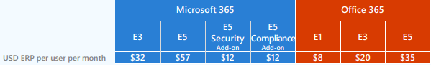
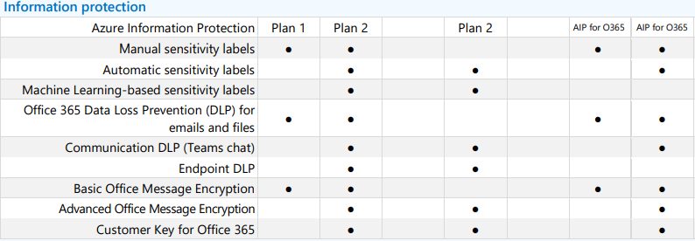
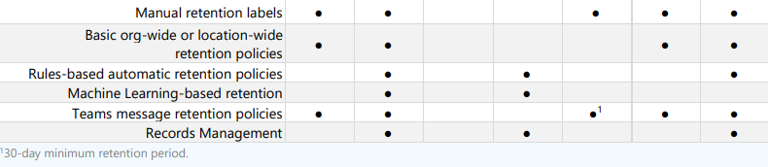
Microsoft 365 Plans (Information Management)
Notes:
Expectation from this slides is to spend some time on few key features and their existance in corresponding plans. Choose some features and highlight them.

Slide 13
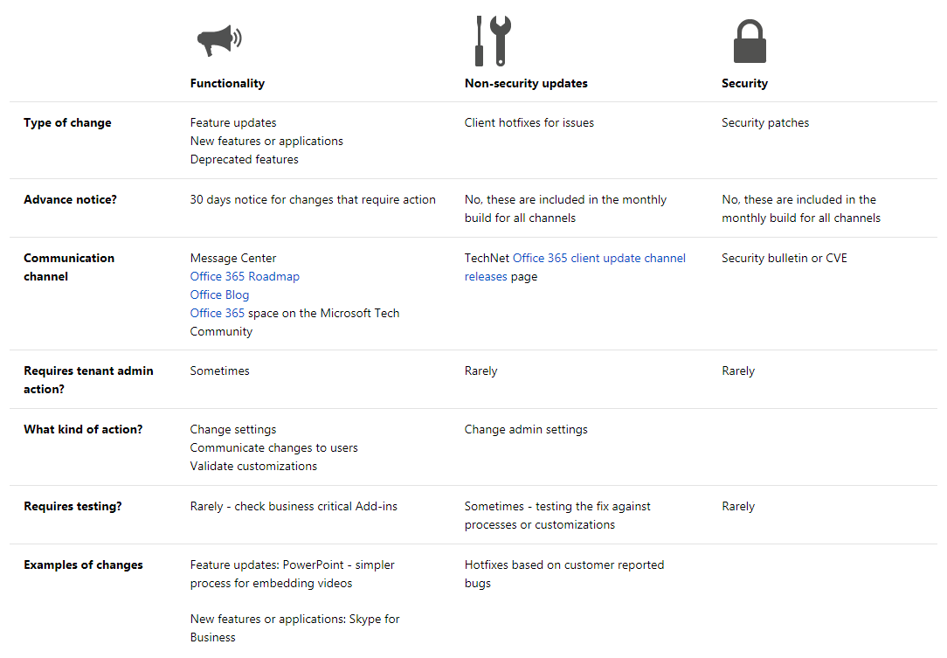
Change Management for Microsoft 365
Notes:
Microsoft 365 Roadmap: http://fasttrack.microsoft.com/roadmap
Office Blog: https://blogs.office.com/
Microsoft 365 space on the Microsoft Tech Community: https://go.microsoft.com/fwlink/p/?linkid=860047
https://technet.microsoft.com/en-us/library/mt584223.aspx

Slide 14
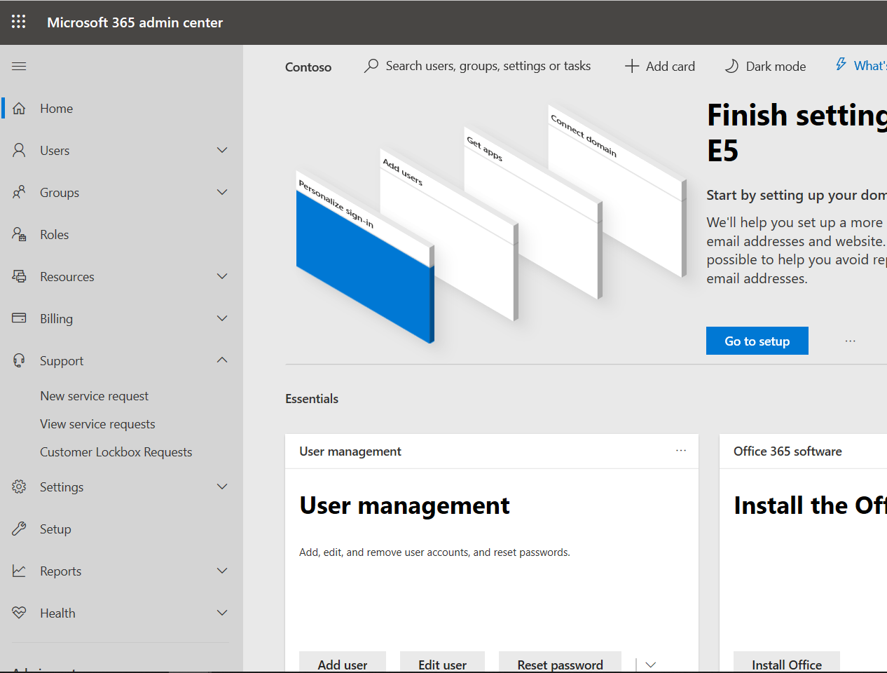
Microsoft 365 Service Support
24 hours a day, seven days a week telephone support
In-product service requests
TechNet and Community help
Phone support for technical and non-technical issues

Slide 15
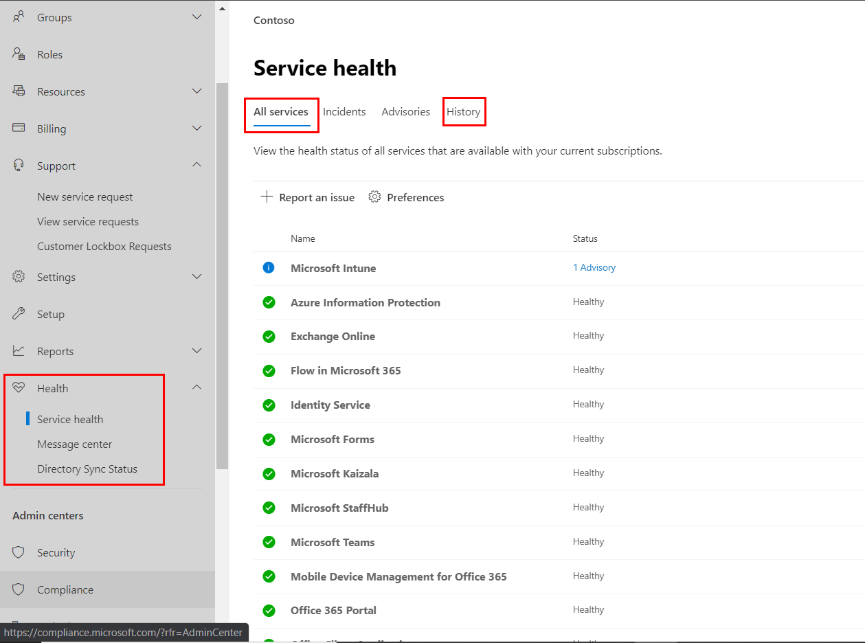
Microsoft 365 Service Health
Service health of Microsoft 365, Yammer, Microsoft Dynamics CRM, and Microsoft Intune cloud services
People who are assigned the global admin or service administrator role can view service health
Check Service health for any known issues and resolution
Service health for
Microsoft 365,
Yammer,
Microsoft Dynamics CRM, and
Microsoft Intune cloud services
View Historical Incidents and Advisories
Incidents and advisories
Notes:
You can view the health of following services on the Microsoft 365 ** Service health ** page in the admin center.
Microsoft 365,
Yammer,
Microsoft Dynamics CRM, and
Microsoft Intune cloud services
If you are experiencing problems with a cloud service, you can check the service health to determine whether this is a known issue with a resolution in progress before you call support or spend time troubleshooting.
Incidents and advisories
Advisory If a service has an advisory shown, we are aware of a problem that is affecting some users, but the service is still available. In an advisory, there is often a workaround to the problem and the problem may be intermittent or is limited in scope and user impact.
Incedents
If a service has an active incident shown, it's a critical issue and the service or a major function of the service is unavailable. For example, users may be unable to send and receive email or unable to sign-in. Incidents will have noticeable impact to users. When there is an incident in progress, we will provide updates regarding the investigation, mitigation efforts, and confirmation of resolution in the Service health dashboard.

Slide 16
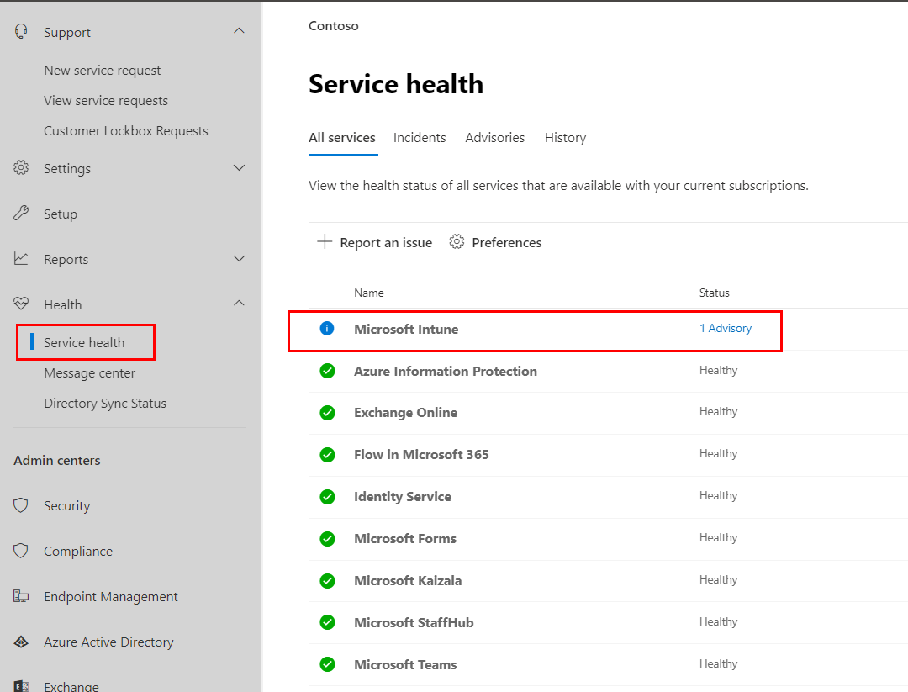
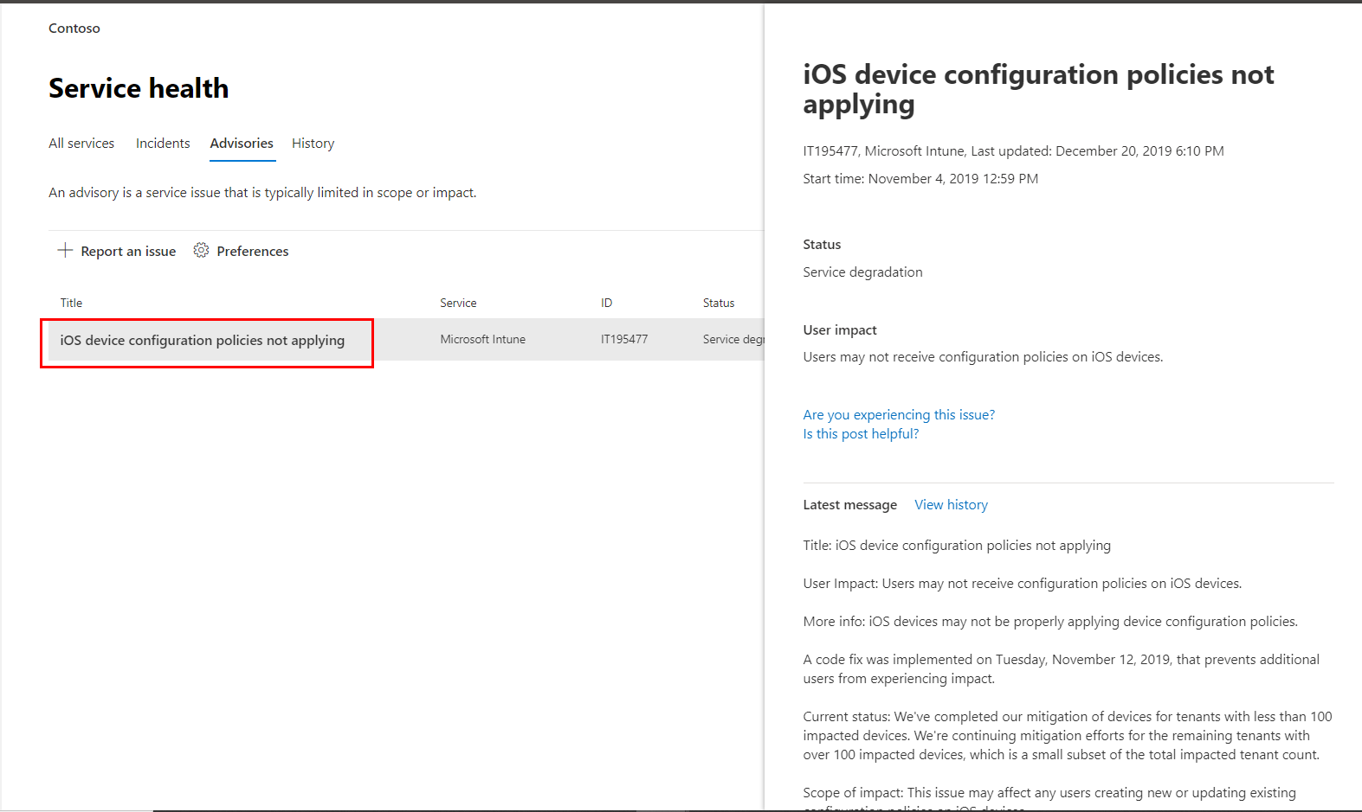
Microsoft 365 Service Health - Details
View details of any posted service health
Notes:
The advisory or incident summary provides the following information:
An issue identifier and summary statement of the problem.
The current status. See status definitions in this article for an explanation of each potential status.
A description of how this issue can affect users.
The time that the issue was started and the last time that the service health message was updated. Throughout the duration of an issue we post frequent messages to let you know the progress that we're making in applying a solution.
Select the Show details link to see more details about the issue, including the history of all messages posted while we work on a solution.

Slide 17
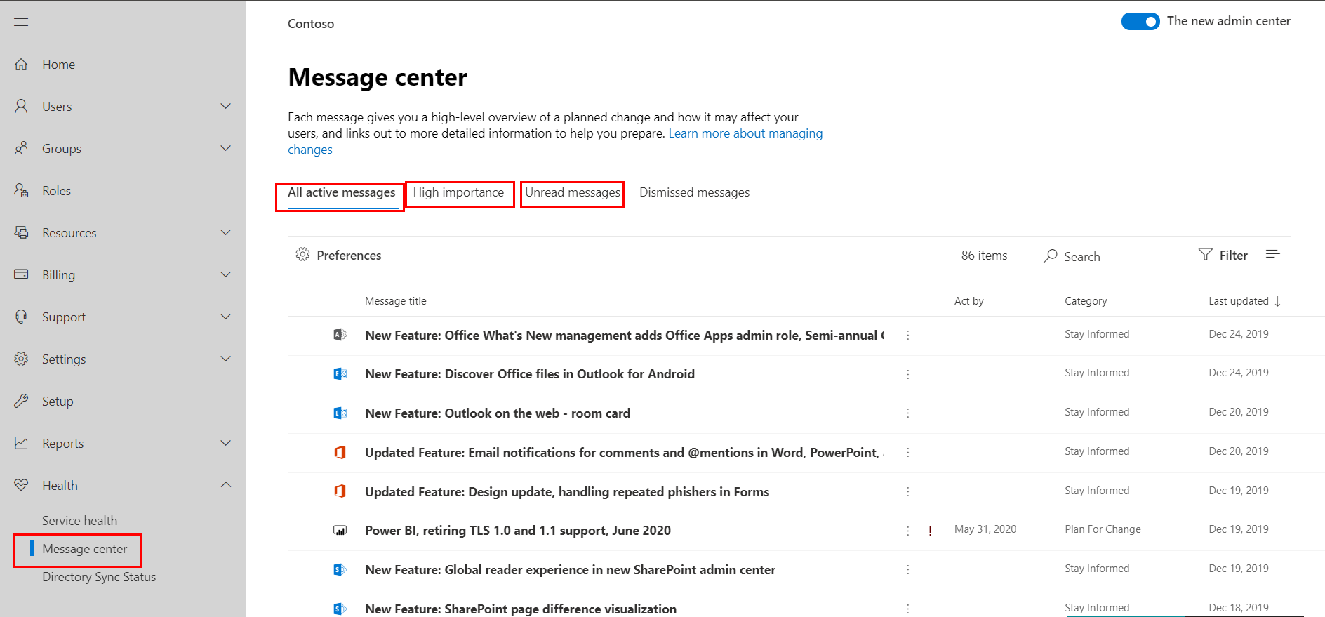
Microsoft 365 Message Center
Microsoft 365 Message Center is used to post upcoming feature releases or issues.
Each post gives a high-level overview of a planned change and how it may affect users
Permissions
Users who have been assigned any admin role in Microsoft 365 can view Message center posts.
You can also assign the Message center reader role to users who should be able to read and share Message center posts without having any other admin privilege
High Importance Updates
Access Microsoft 365 Message Center from Microsoft 365 Admin center
Message Categories
Notes:
To keep track of upcoming feature releases or issues, go to Message center. That's where we post official announcements about new and changed features to enable you to take a proactive approach to change management.
Each post gives you a high-level overview of a planned change and how it may affect your users, and links out to more detailed information to help you prepare.
High Importance Updates
Because High Importance updates are most impactful to your organization, they are highlighted at the top of the Message center as shown in this graphic
High Importance updates are communicated at least 30 days in advance when an action is required.
High Importance updates are defined as:
​Changes to daily productivity such as inbox, meetings, delegations, sharing and access
Changes to the themes, web parts, and other components that may affect customized features
Increases or decreases to visible capacity such as storage, number of rules, items or durations
Changes to product branding that may:
Cause end user confusion,
Result in changes to help desk processes and reference material, or
Change a URL
A new service or application
Changes requiring an admin action (exclusive of prevent or fix issues)
Changes to where your data is stored
Categories
Messages are identified by one of the three following categories:
Prevent or fix issues: These messages inform you of known issues impacting your organization and may require that you take action to avoid disruptions in service. Prevent or fix issues are different than Service health messages because they prompt you to be proactive to avoid issues.
Plan for change: These messages inform you of changes to Microsoft 365 that may require you to act to avoid disruptions in service. For example, we’ll let you know about changes to system requirements or about features that are being removed. We try to provide at least 30 days’ notice of any change that requires an admin to act to keep the service running normally.
Stay informed: This is where we tell you about new or updated features that we are turning on in your organization. The features are usually announced first in the Office Roadmap. Stay informed messages may also let you know about planned maintenance in accordance with our Service Level Agreement. Planned maintenance may result in down time, where you or your users can’t access Microsoft 365, a specific feature, or a service such as email or OneDrive for Business.
Read more here
https://support.office.com/en-us/article/message-center-in-office-365-38fb3333-bfcc-4340-a37b-deda509c2093#ID0EAABAAA=Overview

Slide 18
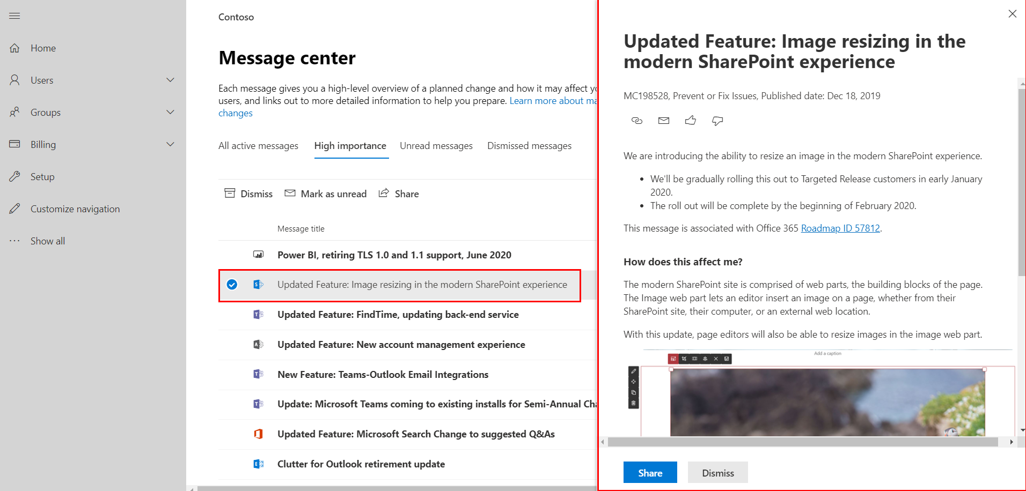
Microsoft 365 Message Center - Details
Microsoft 365 Message Center is used to post upcoming feature releases or issues.
Each post gives a high-level overview of a planned change and how it may affect users
Permissions
Users who have been assigned any admin role in Microsoft 365 can view Message center posts.
You can also assign the Message center reader role to users who should be able to read and share Message center posts without having any other admin privilege
Notes:
Discuss different options available on Update Screen.

Slide 19
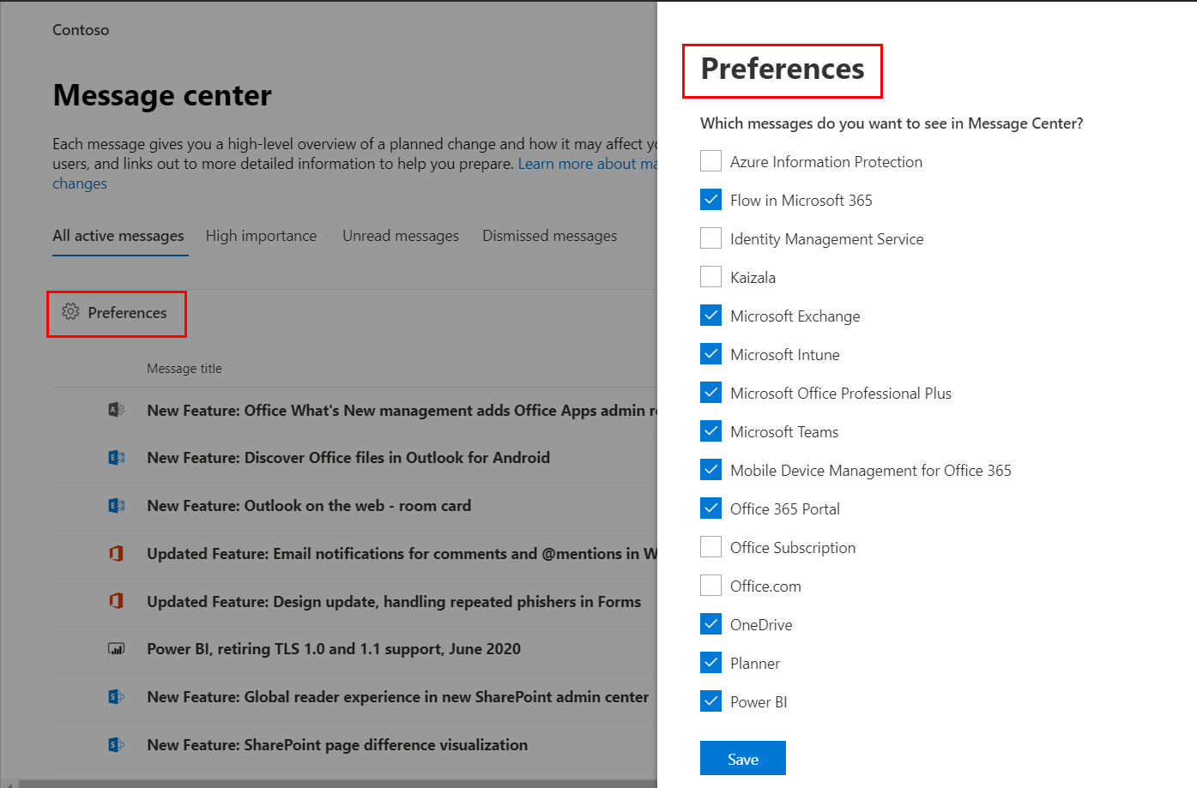
Microsoft 365 Message Center – Message Preferences
In a distributed organization, Each admin can set preferences that control which messages are displayed in Message center.
Opt-in to receive a weekly digest of messages in email.
Message Perferences
Notes:
Discuss different options available on Update Screen.

Slide 20
Knowledge Check
What are the service families provided by Microsoft 365?
In which regions are the Microsoft 365 datacenters located?
Business, Enterprise, Education, and Government
Currently locations are in the United States, European Union, Asia Pacific (APAC), Australia, Canada, France, India, Japan, Korea, Germany, and United Kingdom.
Who can view posts in Message center?
Who can view Microsoft 365 Service Health Dashboard?
Users who have been assigned any admin role in Microsoft 365 can view Message center posts.
You can also assign the Message center reader role to users.
People who are assigned the global admin or service administrator role can view service health.

Slide 21
Summary
In this lesson, you learned about the services and benefits that are provided by Microsoft 365

